Slide 1
CHRISTMAS AT EVE
BE FESTIVELY TEMPTED

Slide 2
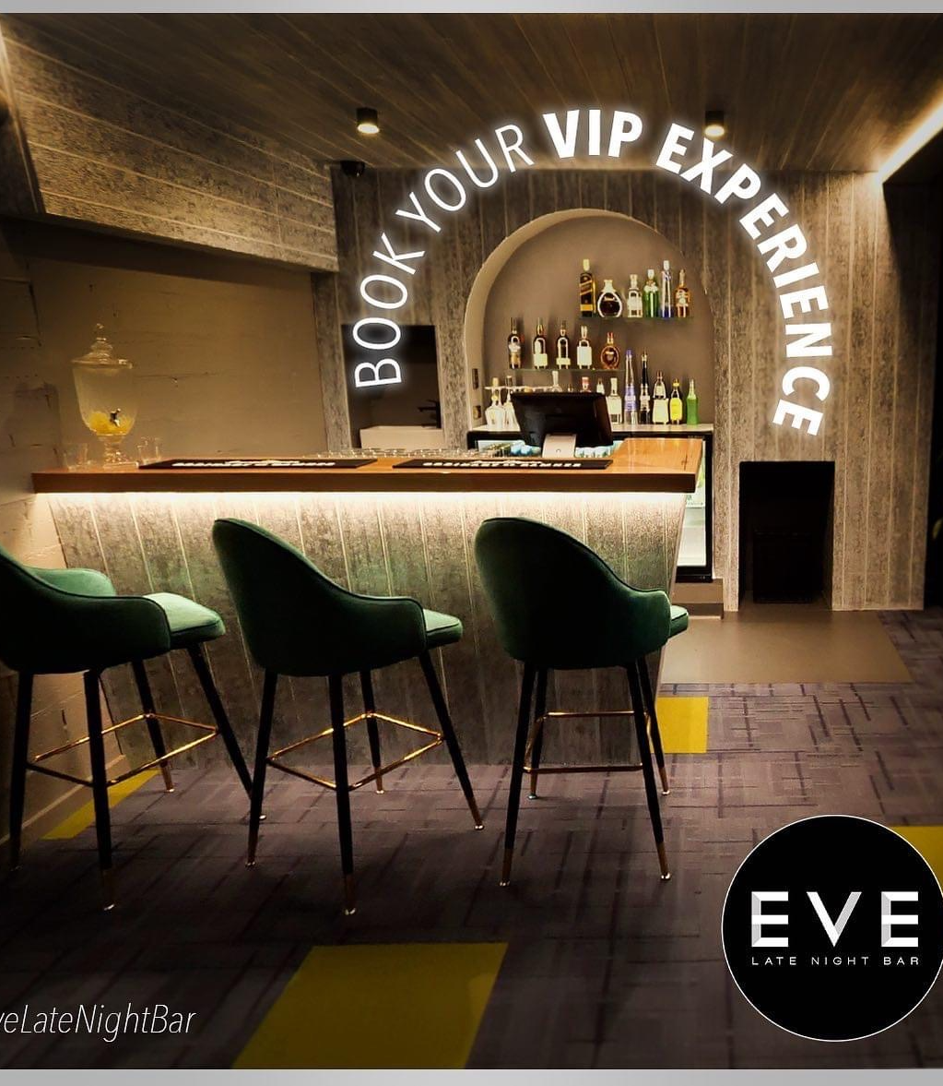
Contents
Welcome to Eve
Preferred Caters
Catering Options
Beverage Package
Cocktail Package
Function Space
Terms & Conditions
Confirmation of Function Booking
Contact Details

Slide 3
Welcome To Eve Late Night Bar, Albany
Eve Late Night Bar has a rich history as an entertainment venue, visible in the restored murals in our main bar-. Built in 1972 by Franceso and Isabella Forgione, for 45 years this was the tallest building in Albany. Remaining within the Family, the next generation have taken inspiration from their European heritage and have turned their collective vision of creating a premium venue, that prides itself on impeccable service- into a reality. As a family-owned business, there is an emphasis on creating a quality establishment for the people of Albany; a town that has provided their own family not only a home, but so many opportunities. This personal connection ensures a dedication towards every patron, every function and to making every experience within the venue a memorable one.
Eve Late Night Bar provides a beautiful, architecturally designed space that is reinvigorating the age-old era of the Lounge Bar. Our Venue offers a meeting place with a focus on comfort, safety and quality service of premium spirits, locally harvested wines and quintessential cocktails.
The aesthetic design, sound synchronised lighting and balanced acoustics create a unique, ambient atmosphere that was conceptualised for the enjoyment of our guests.
As stated in the Albany Advertiser in January 2023:
“Locals and visitors have since warmly embraced the Eve concept, and it has quickly
established itself as a great place to kick off or wind up a classy night out” .
Whether it be a quaint meeting of friends, a corporate function or a celebration, the team at Eve Late Night Bar will work with you to create the event you desire. From Music Selection, Decoration, Signature Cocktail Creation and Catering coordination, let our dedicated team take your vision and turn it into a memorable event.
We have the capacity to cater for functions 7 days a week, whether they be private events within the dedicated VIP lounge, which incorporates a private bartender, toilet facilities and courtyard; or the whole venue which can be exclusively hired for parties of up to 260 guests (and everything in between).
We look forward to working with you for your event.

Slide 4
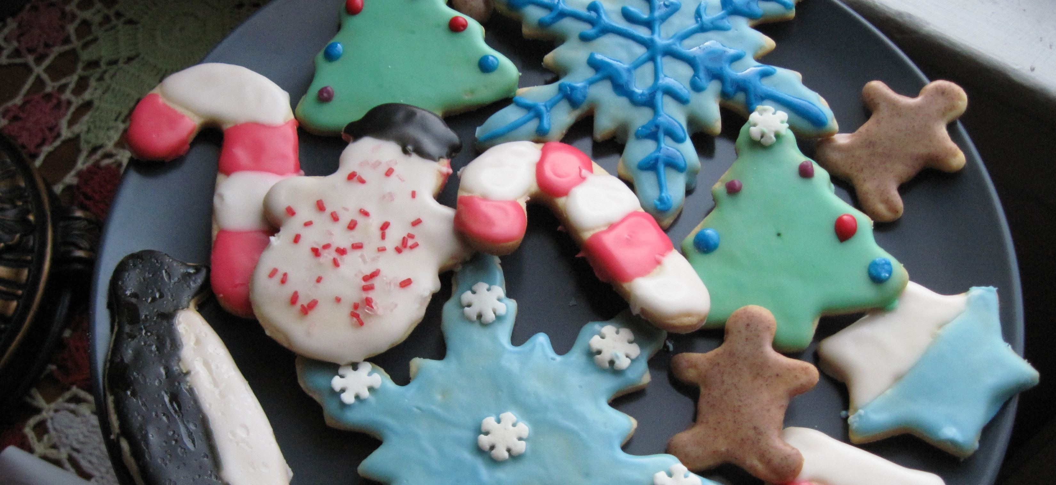
Catering Options
This Photo by Unknown Author is licensed under CC BY-SA

Slide 5
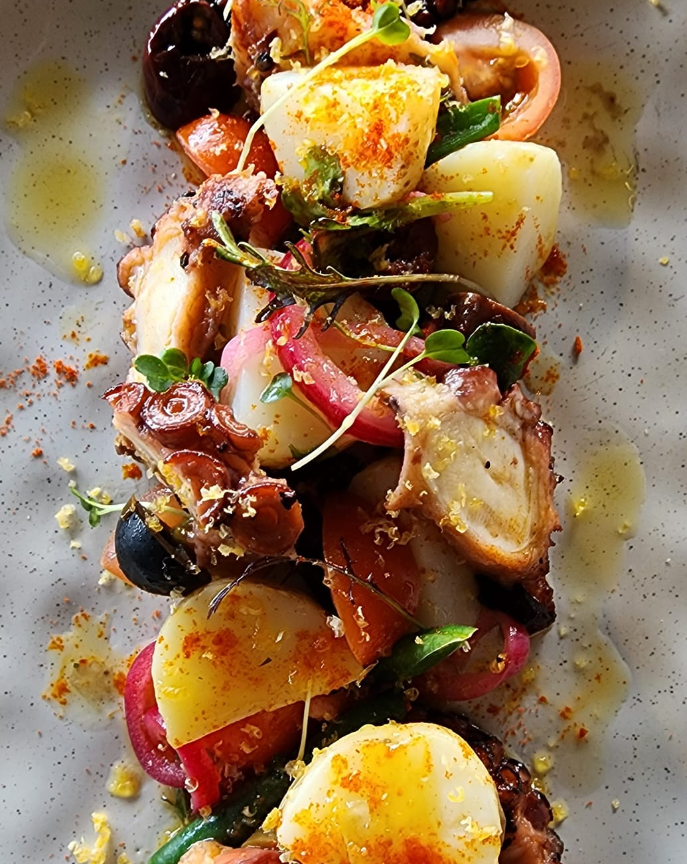
Catering Options

Slide 6
PREFERED CATERING OPTIONS $35 per head for 5 options below additional options are priced as per below Prices are indicative of 1 piece per person per selection. Extra servings will incur a higher cost.
NON VEGETARIAN
House Made Sausage Rolls with Tomato Relish $5.50
Camembert and Caramelised Onion Tart $5.00
Lemon Pepper Prawn Cutlets $5.5
Satay Chicken Skewers w dipping sauce $5.00
Teriyaki Squid w Kewpie Mayo $5.00
Crispy Sweet Chilli Glazed Pork Belly Bites $5.50
Pulled Beef Sliders/Bao with coleslaw and Sriracha Mayo $5.00
Yellow Chicken curry and rice $6.00
Fried Rice – Duck and veg $6.00
DESSERTS- $5.50
Key lime Pie
Double Chocolate Brownie
Almond Friands – assorted
Chocolate Mousse cups
Mini Pavlovas with Cream
Chocolate Truffle assorted
Mini Cheescake - Assorted flavours
Grazing Boards – Your choice of Cheeses, Cold Cuts, Olives, Breads and Dips. Price subject to selection. 7
(Grazing Board prices are subject to change regarding item choice and current market pricing)

Slide 7
PREFERED CATERING OPTIONS $35 per head for 5 options below additional options are priced as per below Prices are indicative of 1 piece per person per selection. Extra servings will incur a higher cost.
NON VEGETARIAN
House Made Sausage Rolls with Tomato Relish $5.50
Camembert and Caramelised Onion Tart $5.00
Lemon Pepper Prawn Cutlets $5.5
Satay Chicken Skewers w dipping sauce $5.00
Teriyaki Squid w Kewpie Mayo $5.00
Crispy Sweet Chilli Glazed Pork Belly Bites $5.50
Pulled Beef Sliders/Bao with coleslaw and Sriracha Mayo $5.00
Yellow Chicken curry and rice $6.00
Fried Rice – Duck and veg $6.00
DESSERTS- $5.50
Key lime Pie
Double Chocolate Brownie
Almond Friands – assorted
Chocolate Mousse cups
Mini Pavlovas with Cream
Chocolate Truffle assorted
Mini Cheescake - Assorted flavours
Grazing Boards – Your choice of Cheeses, Cold Cuts, Olives, Breads and Dips. Price subject to selection. 7
(Grazing Board prices are subject to change regarding item choice and current market pricing)

Slide 8
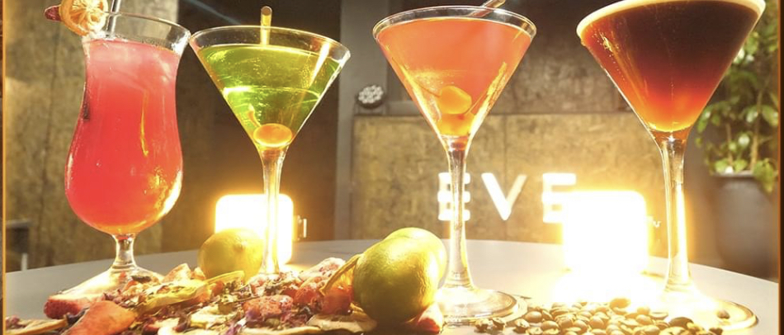
Beverage Packages
All Inclusive Beer, Wine and Soft Drink
Packages Per person/per hour
you can have standalone
or add a cocktail package
Select 4 cocktails from our cocktail menu. Fresh pressed juices, garnishes, elegant glassware, barware. We are here to create a hassle-free cocktail party for you! Mocktail drinkers worry no more! We can produce most of our cocktails using a brand-new NON-ALCOHOLIC spirit range. Ensure your non-alcohol drinkers are included in all the fun!
Signature Cocktail service available- Create an event themed cocktail !

Slide 9
BEVERAGE PACKAGE- 30 people minimum (Price per person)
Selection
Wine:
Sparkling: Lenton Brae Blanc De Blanc
White: Ferngrove Sauvignon Blanc
Rosé: Wignalls Rose
Red: Monty Leap Far King Shiraz
Beer:
Swan Draught Lager 4.5%,
Little Creatures ‘Rogers’
Soft Drinks
2hrs $55 | 3hrs $70 | 4hrs $75

Slide 10
COCKTAIL PACKAGE
Japanese Slipper
Triple Sec, Midori, Lime Juice and finished with Maraschino Cherries
Cosmopolitan *
Vodka, Triple Sec, Lime Juice, Cranberry Juice, Maraschino Cherries
Espresso Martini *
Traditional Kahlua, Espresso Coffee, Vodka
Fruit Tingle*
Vodka, Blue Curacao, Lemonade and grenadine
True Blue
Malibu Rum, Blue Curacao, Ginger Beer
Tropical Haze
Cointreau, Midori Melon Liqueur & Pineapple Juice
Mocktail:
Made to Order or as above marked with *
Priced on application

Slide 11
FUNCTION SPACE- Private Functions
VIP ROOM AND COURTYARD:
(Light Grey Shaded Area)
MAXIMUM OF 50 PEOPLE
(PLEASE NOTE THIS OPTION ALLOWS TOTAL EXCLUSIVITY OF THE VIP AREA. A CODE CAN BE USED TO SEPARATE THE FUNCTRION FROM THE GENERAL PUBLIC. THE ONLY SHARED AREA WILL BE THE COURTYARD, THE VIP SECTION WILL BE CORNEDED OFF FOR YOUR GUESTS ONLY)
EXTENDED VIP AREA:
(Dark Grey Shaded Area)
MAXIMUM OF 100 PEOPLE
(PLEASE NOTE THIS ARE A WILL BE CORDENED OFF BETWEEN THE VIP ROOM AND EXTEND TO THE COCKTAIL BAR, THE GENERAL PUBLIC WILL HAVE ACCESS TO THE REMAINDER OF THE ROOM)
AVAILABLE 7 DAYS A WEEK

Slide 12
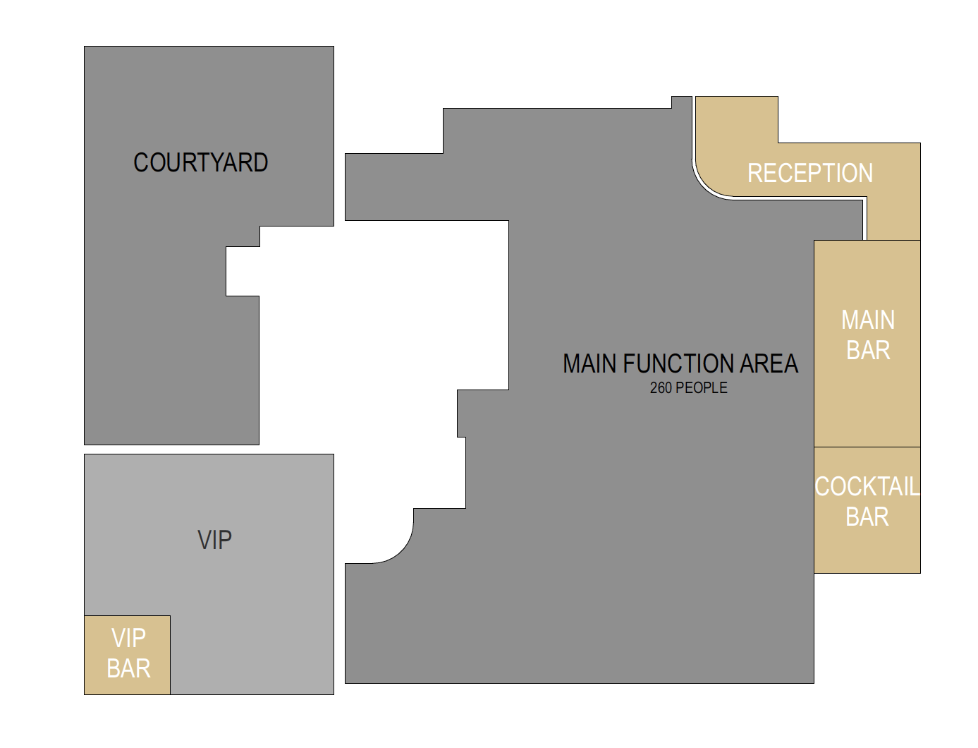
FUNCTION SPACE - Exclusive Venue Hire
EXCLUSIVE VENUE HIRE
(Whole Venue)
Maximum of 260 People
(Please note this option is available from 6pm Sunday through Thursday. Functions on a Friday or Saturday Night after 9pm will be open to the public. )

Slide 13
TERMS & CONDITIONS CONDITIONS
CONFIRMATION OF BOOKING / DEPOSIT We require a deposit of $300 (20% 0f $1500 MINIMUM SPEND) within 7 days of tentatively booking your function. The deposit amount will be deducted from the remaining balance at the conclusion of your event. Your booking is not confirmed until the deposit and the booking form are received. EVE LATE NIGHT BAR has the right to reallocate your space on the day if your booking has not been confirmed. CONFIRMATION OF FINAL NUMBERS To ensure the smooth running of your event, we request that you confirm guest numbers, food and beverage selections no later than 7 days prior to your function date. If final numbers are not provided, the highest estimated number of guests, as advised on the booking form, will be confirmed. If numbers do increase, we require you pay the extra associated costs. If numbers decrease, you will still be charged at the rate you quoted in confirmed numbers. CANCELLATIONS All cancellations must be made in writing/email to the Event Manager. If cancellation occurs within 14 days prior to your function, the deposit will be forfeited. TENTATIVE BOOKINGS All tentative bookings will be held for a period of 7 days, otherwise your tentative booking will lapse. We will make all attempts to contact you if another enquiry is received for the same date and same space. If you would like to confirm your tentative booking, ‘Confirmation of Function Booking’ sheet is to be completed and returned to the Event Manager with the $300 deposit. TERMS & CONDITIONS require a total minimum spend on selected area. When selecting food catering options through our preferred recommended caters (catering is outsourced) these must be confirmed at least 7 days before your function. We can help select platters to ensure these food requirements are met. Please advise of guest dietary needs or allergies. FINAL PAYMENTS Final payment for your function is required on the day. We accept MasterCard, Visa, EFTPOS and cash (we do not accept cheques unless prior approval has been granted). Direct deposits must be arranged prior to the function and a copy of the remittance emailed or faxed at the time of payment. If the final payment is not made, EVE LATE NIG HT BAR reserves the right to deduct the balance from the credit card supplied on the function booking form. Please note - we do not facilitate separate billing. PRICING The Management at EVE LATE NIGHT BAR reserve the right to increase prices. We also review the function packages on a regular basis and possible price increases may result. While every endeavour is made to maintain prices as quoted, market variations and unforeseen circumstances may result in cost increase. Should any changes occur within the coordination time of your function, you will be advised no later than 14 days prior to the function date. . SECURITY At all times, patrons must have access to their current valid photographic identification. Failure to show this ID on request may result in admittance to the venue being denied. Security staff, at their discretion, have the right to refuse entry to any person. Staff have the right to remove any patron from the premises deemed to be acting in an inappropriate or intoxicated manner.

Slide 14
TERMS & CONDITIONS
RESPONSIBILITY & DAMAGE EVE LATE NIGHT BAR does not accept responsibility for damages to, or loss of, any patron’s property left on the premises prior to, during or after a function. Organisers are financially responsible for any damages to property belonging to EVE LATE NIGHT BAR, by the client or guests, prior to, during or after your function. DUTY OF CARE In the interests of the responsible service of alcohol, we have a duty of care to all our patrons and reserve the right for management or bar staff to refuse the service of alcohol to persons deemed to be intoxicated. If a bar tab has been set up, EVE LATE NIGHT BAR reserves the rights to refuse the service of alcohol to a member of the function if deemed intoxicated, this includes other patrons gaining alcoholic beverages for any member(s) of your party who may have been refused service due to intoxication. We reserve the right to request security to escort persons we deem to be intoxicated and/or may do harm to themselves, other patrons, or property from our venue. If guests are removed from the premises, no refund is offered on food, beverage, or associated costs DECORATIONS We would love for your event to be extra special and allow the use of decorations or balloons, but EVE LATE NIGHT BAR does not allow guests to fix decorations and/or signs in any way to the establishment walls or its fittings. The use of confetti or party confetti/poppers is not allowed in any area. If you are organising a vendor to set up for your event, please contact your Event Manager to organise a time that suits the venue for both set up and pickup. Any decorations that are left on premises, unless prior arrangements have been made, may be discarded by the venue. COVID-19 POLICY All guests must comply with current government mandates and follow venue’s instructions for terms of entry. In case of government regulations and changes that affect the hospitality industry, we may contact you to make changes to your function. If the venue cannot accommodate your function to comply with government changes, you will be given the option to postpone or be provided with a refund of your deposit. If the organiser wishes to cancel or postpone their event where the venue could accommodate them, refer to the cancellation policy. . FOOD PREPARATION & TAKE-HOME FOOD All food is prepared to be consumed on our premises. Should the host wish to take leftover food items away from our premises at the conclusion of a function, they do so at their own risk. EVE LATE NIGHT BAR practices safe food handling and hygiene and urges patrons to take every precaution when storing and consuming food. We do not permit food or drinks to be brought in from outside the venue. Please discuss with your Event Manager should you wish to bring a celebration cake.

Slide 15
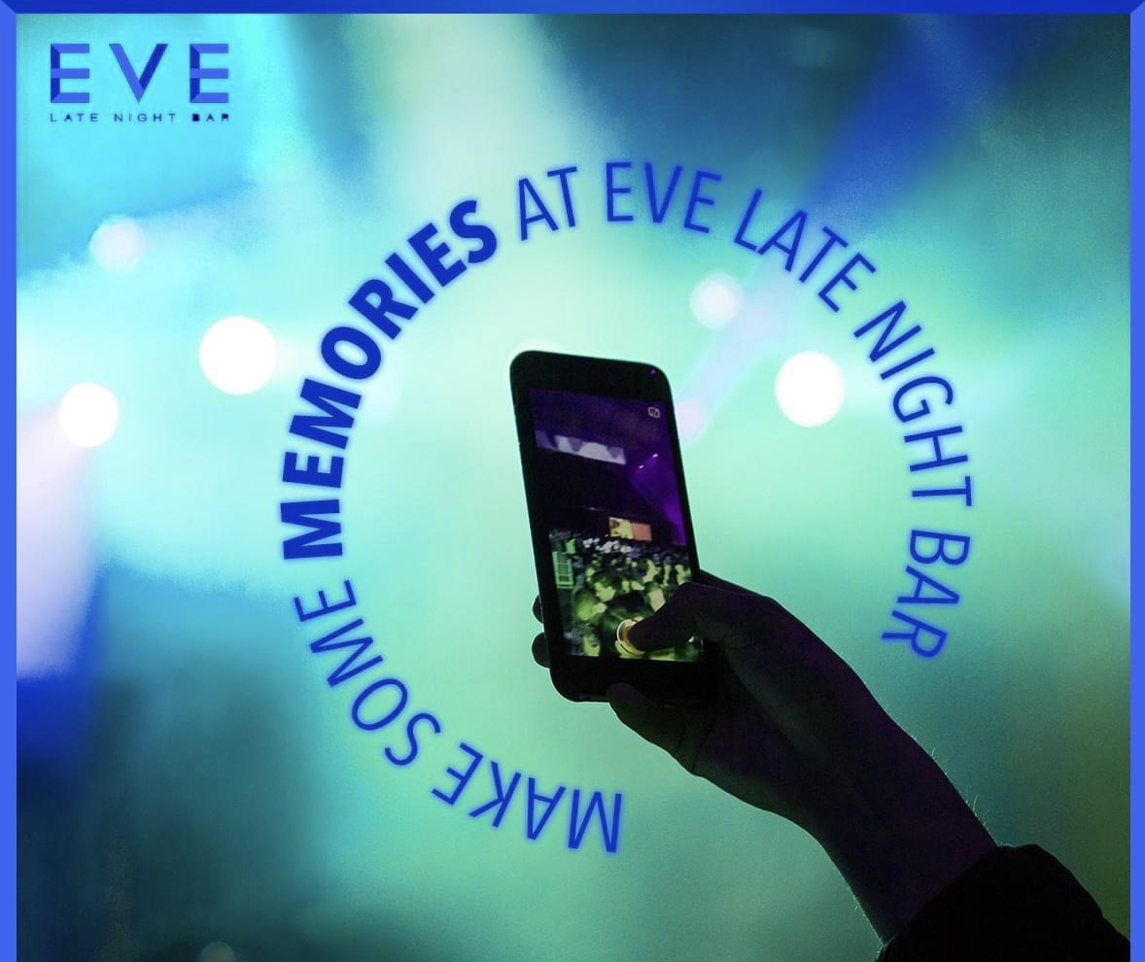
CONFIRMATION OF FUNCTION BOOKING
PERSONAL DETAILS
EVENT ORGANISER: ____________________COMPANY: ____________________
ADDRESS: _________________________________________________________
PHONE: (H) ________________ (W) ________________ (M) ________________
EMAIL: ___________________________________________________________
FUNCTION DETAILS
DATE: ____________ TIME: ____________ NUMBER OF GUESTS:_____________
OCCASION: ___________________ ROOM REQUIRED: _____________________
CONTACT ON THE DAY: _______________________________________________
UNSETTLED BILL PAYMENTS / DEPOSIT (Visa|Mastercards|Dinners)
NAME: _____________________ CARD NUMBER: ________________________ EXPIRY:_____________________ VERIFICATION NUMBER: _________________
SIGNATURE AUTHORISATION I have read and understood the Terms and Conditions above and accept responsibility for abiding by these terms. If guest number decrease, I understand that I will be charged for the number of guests quoted in confirmed numbers. If numbers increase, I will be charged for the associated costs.
SIGNED: ______________________________ DATE: _______________________

Slide 16
To Be tempted Further Contact Events at Eve:
EVENTS MANAGER- ARIELLE PEAT- 0400 929 682
EVENTS@EVELATENIGHTBAR.COM.AU
VENUE MANAGER- BRAD HOPPERTON 0439 447 450
MANAGER@EVELATENIGHTBAR.COM.AU

